Slide 1
Database Management System
A set of program to define, construct & manipulate database

Slide 2
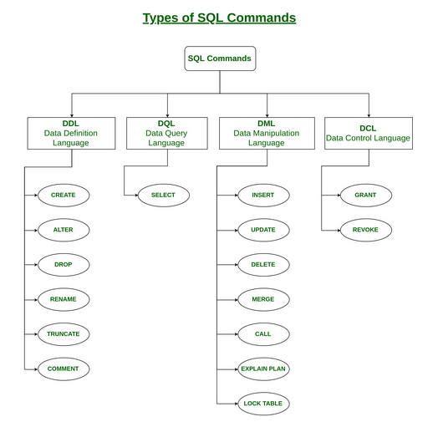

Slide 3
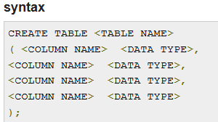
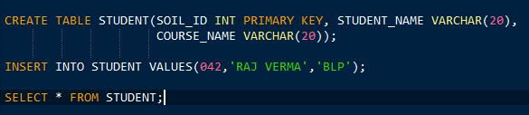
Defining Database
Defining datatype, structure
Data Definition command we use generally are
CREATE- Main use of create command is to create a new table in database

Slide 4

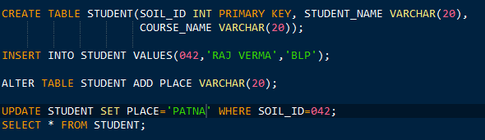

Defining Database
2. ALTER - An existing database object can be modified using the alter command

Slide 5
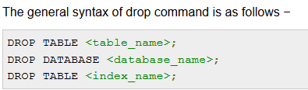
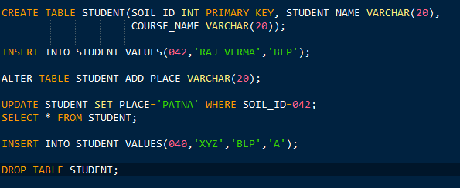
Defining Database
3. DROP- Any component from a database can be removed using the Drop command
In this case whole table STUDENT will be deleted

Slide 6
Constructing a Database
It tells how the database can be constructed and where it can be constructed
MySQL Server - Your computer can act as the server
Server maintenance fees (your computer can be the server)
AWS hosted database server- AWS hosts the server
storage fees + data transfer fees (12 month grace period)

Slide 7

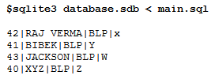
Manipulating a database
INSERT- It is used to insert data into a table.

Slide 8
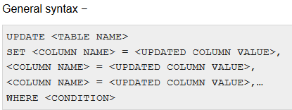
Manipulating a database
UPDATE- It is used to insert data into a table.

Slide 9

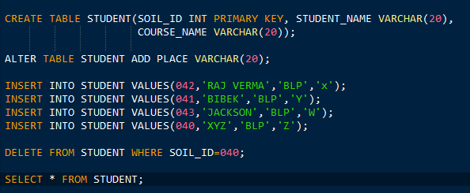

Manipulating a database
DELETE- Deletes records from the database table according to the given constraints.

Slide 10
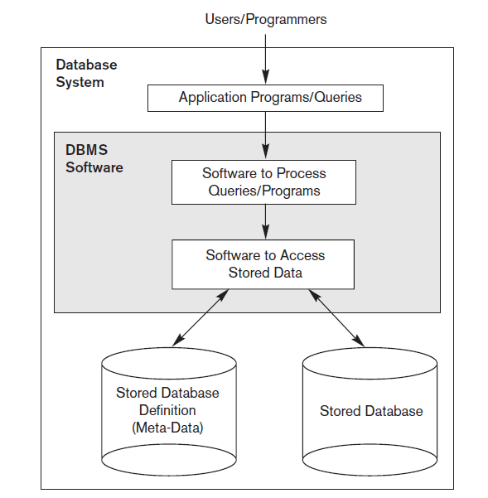

Slide 11
DESIGNING OF A DATABASE
CONCEPTUAL
LOGICAL
PHYSICAL
ER DIAGRAM
RDBMS- how to implement the data model
How to store and access from the database- SQL is used

Slide 12
Conceptual
Conceptual data models use concepts such as entities, attributes, and relationships
What is Entity- a real-world object or concept, such as an employee
What is Attribute- some property of interest that further describes an entity, such as the employee’s name or salary.
Relationship- Among two or more entities represents an association for example, a works-on relationship between an employee and a project
Terminologies-
A column header is called an attribute,
A row is called a tuple,
The table is called a relation
So inside a relation there will be n number of attributes. For ex
SOIL_STUDENT(Name, SoilID, Address, Mobile Number, Age, Percentage)
SOIL_STUDENT name of the relation/table
Name, SoilID, Address, Mobile Number, Age, Percentage attributes/ column of the table

Slide 13
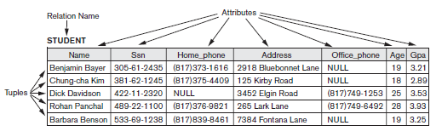
Conceptual

Slide 14
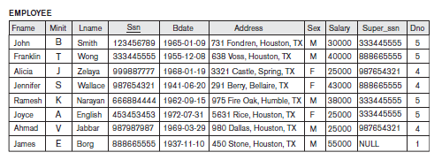
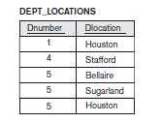
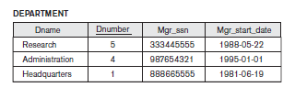
A typical Relational Database schema

Slide 15
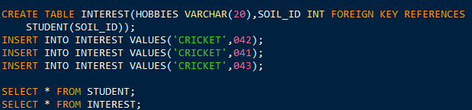
PRIMARY KEY & FOREIGN KEY
SOIL_ID | STUDENT_NAME | COURSE_NAME | PLACE
042 | RAJ VERMA | BLP | X
041 | BIBEK | BLP | Y
043 | JACKSON | BLP | W
SOIL_ID | HOBBIES
042 | CRICKET
041 | CRICKET
043 | CRICKET

